Slide 1

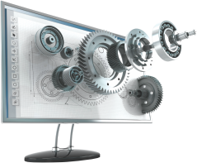
Python for Beginners
Archer Infotech , PUNE
www.archerinfotech.in

Slide 2
Python – AI , ML,DL, DS

Slide 3
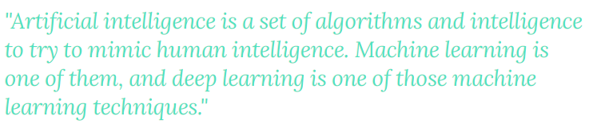

Slide 4
What is Artificial Intelligence ?
"It is a branch of computer science by which we can create intelligent machines which can behave like a human, think like humans, and able to make decisions.“
With the help of AI, you can create such software or devices which can solve real-world problems very easily and with accuracy such as health issues, marketing, traffic issues, etc.
With the help of AI, you can create your personal virtual Assistant, such as Cortana, Google Assistant, Siri, etc.
With the help of AI, you can build such Robots which can work in an environment where survival of humans can be at risk.

Slide 5
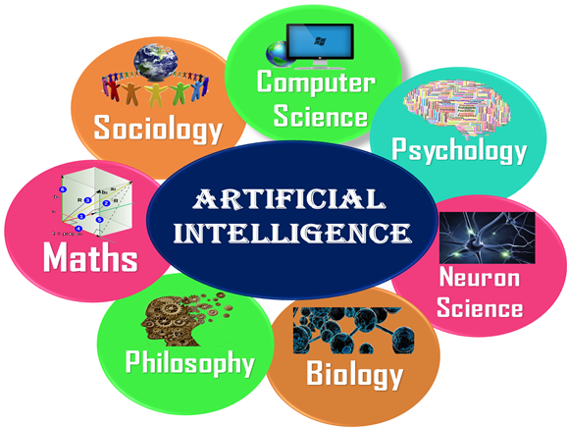
What Comprises Artificial Intelligence ?

Slide 6
AI Advantages
High Accuracy with less errors: AI machines or systems are prone to less errors and high accuracy as it takes decisions as per pre-experience or information.
High-Speed: AI systems can be of very high-speed and fast-decision making, because of that AI systems can beat a chess champion in the Chess game.
High reliability: AI machines are highly reliable and can perform the same action multiple times with high accuracy.
Useful for risky areas: AI machines can be helpful in situations such as defusing a bomb, exploring the ocean floor, where to employ a human can be risky.
Digital Assistant: AI can be very useful to provide digital assistant to the users such as AI technology is currently used by various E-commerce websites to show the products as per customer requirement.
Useful as a public utility: AI can be very useful for public utilities such as a self-driving car which can make our journey safer and hassle-free, facial recognition for security purpose, Natural language processing to communicate with the human in human-language, etc.

Slide 7
AI Disadvantages
High Cost: The hardware and software requirement of AI is very costly as it requires lots of maintenance to meet current world requirements.
Can't think out of the box: Even we are making smarter machines with AI, but still they cannot work out of the box, as the robot will only do that work for which they are trained, or programmed.
No feelings and emotions: AI machines can be an outstanding performer, but still it does not have the feeling so it cannot make any kind of emotional attachment with human, and may sometime be harmful for users if the proper care is not taken.
Increase dependency on machines: With the increment of technology, people are getting more dependent on devices and hence they are losing their mental capabilities.
No Original Creativity: As humans are so creative and can imagine some new ideas but still AI machines cannot beat this power of human intelligence and cannot be creative and imaginative.

Slide 8
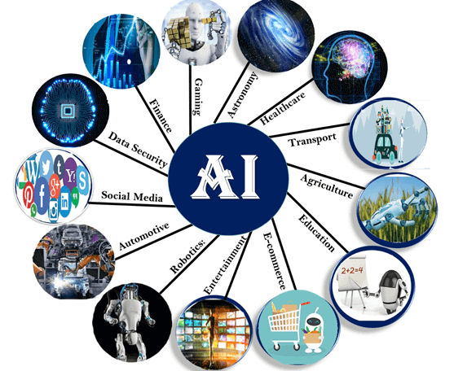
Applications of AI

Slide 9
What is Machine Learning?
Machine Learning is said as a subset of artificial intelligence that is mainly concerned with the development of algorithms which allow a computer to learn from the data and past experiences on their own..
Machine learning enables a machine to automatically learn from data, improve performance from experiences, and predict things without being explicitly programmed
A machine has the ability to learn if it can improve its performance by gaining more data

Slide 10
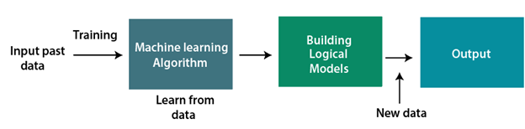
How Machine Learning works ?
A Machine Learning system learns from historical data, builds the prediction models, and whenever it receives new data, predicts the output for it. The accuracy of predicted output depends upon the amount of data, as the huge amount of data helps to build a better model which predicts the output more accurately.

Slide 11
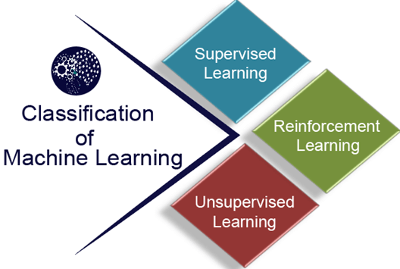
Machine Learning Classification

Slide 12
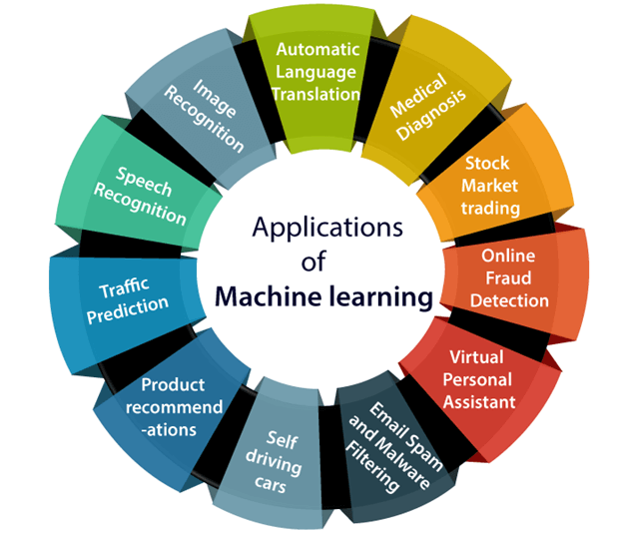
Machine Learning Applications

Slide 13
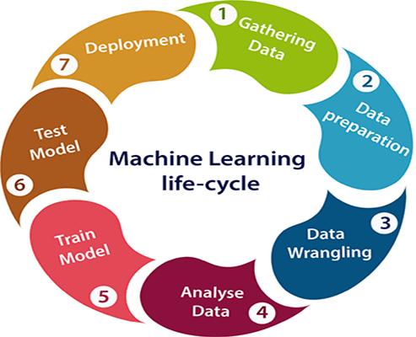
Machine Learning Life Cycle

Slide 14
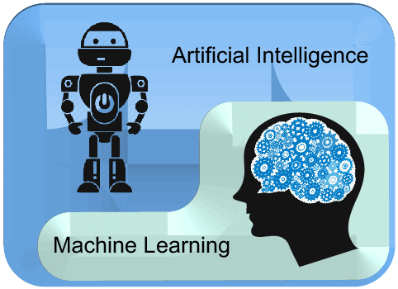
Difference between AI & ML
AI is a bigger concept to create intelligent machines that can simulate human thinking capability and behavior, whereas, machine learning is an application or subset of AI that allows machines to learn from data without being programmed explicitly.

Slide 15

Difference Between AI & ML
Artificial Intelligence | Machine learning
Artificial intelligence is a technology which enables a machine to simulate human behavior. | Machine learning is a subset of AI which allows a machine to automatically learn from past data without programming explicitly.
The goal of AI is to make a smart computer system like humans to solve complex problems. | The goal of ML is to allow machines to learn from data so that they can give accurate output.
In AI, we make intelligent systems to perform any task like a human. | In ML, we teach machines with data to perform a particular task and give an accurate result.
Machine learning and deep learning are the two main subsets of AI. | Deep learning is a main subset of machine learning.
AI has a very wide range of scope. | Machine learning has a limited scope.
AI is working to create an intelligent system which can perform various complex tasks. | Machine learning is working to create machines that can perform only those specific tasks for which they are trained.
AI system is concerned about maximizing the chances of success. | Machine learning is mainly concerned about accuracy and patterns.
The main applications of AI are Siri, customer support using catboats, Expert System, Online game playing, intelligent humanoid robot, etc. | The main applications of machine learning are Online recommender system, Google search algorithms, Facebook auto friend tagging suggestions, etc.

Slide 16
What is Deep Learning ?
Deep Learning is the subset of machine learning or can be said as a special kind of machine learning. It works technically in the same way as machine learning does, but with different capabilities and approaches.
It is inspired by the functionality of human brain cells, which are called neurons, and leads to the concept of artificial neural networks. It is also called a deep neural network or deep neural learning.
In deep learning, models use different layers to learn and discover insights from the data.
Some popular applications of deep learning are self-driving cars, language translation, natural language processing, etc.
Some popular deep learning models are:
Convolutional Neural Network , Recurrent Neural Network
Autoencoders , Classic Neural Networks, etc.

Slide 17
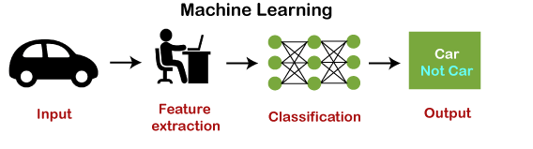
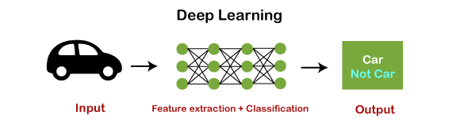
How ML & DL Works

Slide 18
Comparison between ML & DL
Parameter | Machine Learning | Deep Learning
Data Dependency | Although machine learning depends on the huge amount of data, it can work with a smaller amount of data. | Deep Learning algorithms highly depend on a large amount of data, so we need to feed a large amount of data for good performance.
Execution time | Machine learning algorithm takes less time to train the model than deep learning, but it takes a long-time duration to test the model. | Deep Learning takes a long execution time to train the model, but less time to test the model.
Hardware Dependencies | Since machine learning models do not need much amount of data, so they can work on low-end machines. | The deep learning model needs a huge amount of data to work efficiently, so they need GPU's and hence the high-end machine.
Feature Engineering | Machine learning models need a step of feature extraction by the expert, and then it proceeds further. | Deep learning is the enhanced version of machine learning, so it does not need to develop the feature extractor for each problem; instead, it tries to learn high-level features from the data on its own.

Slide 19
Comparison between ML & DL
Problem-solving approach | To solve a given problem, the traditional ML model breaks the problem in sub-parts, and after solving each part, produces the final result. | The problem-solving approach of a deep learning model is different from the traditional ML model, as it takes input for a given problem, and produce the end result. Hence it follows the end-to-end approach.
Interpretation of result | The interpretation of the result for a given problem is easy. As when we work with machine learning, we can interpret the result easily, it means why this result occur, what was the process. | The interpretation of the result for a given problem is very difficult. As when we work with the deep learning model, we may get a better result for a given problem than the machine learning model, but we cannot find why this particular outcome occurred, and the reasoning.
Type of data | Machine learning models mostly require data in a structured form. | Deep Learning models can work with structured and unstructured data both as they rely on the layers of the Artificial neural network.
Suitable for | Machine learning models are suitable for solving simple or bit-complex problems. | Deep learning models are suitable for solving complex problems.

Slide 20
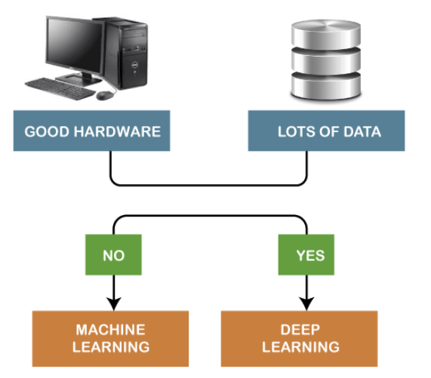
Which one to Select ?

Slide 21
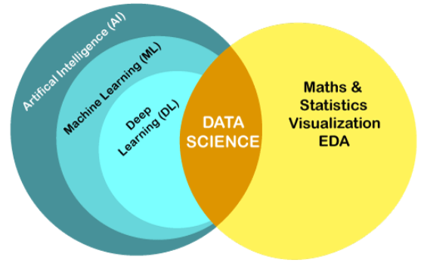
Difference between Data Science & Machine Learning

Slide 22
Difference between Data Science & Machine Learning
Data Science is the study of data cleansing, preparation, and analysis, while machine learning is a branch of AI and subfield of data science.
Data Science and Machine Learning are closely related to each other but have different functionalities and different goals. At a glance, Data Science is a field to study the approaches to find insights from the raw data. Whereas, Machine Learning is a technique used by the group of data scientists to enable the machines to learn automatically from the past data.

Slide 23
Difference between Data Science & Machine Learning
Data Science | Machine Learning
It deals with understanding and finding hidden patterns or useful insights from the data, which helps to take smarter business decisions. | It is a subfield of data science that enables the machine to learn from the past data and experiences automatically.
It is used for discovering insights from the data. | It is used for making predictions and classifying the result for new data points.
It is a broad term that includes various steps to create a model for a given problem and deploy the model. | It is used in the data modeling step of the data science as a complete process.
A data scientist needs to have skills to use big data tools like Hadoop, Hive and Pig, statistics, programming in Python, R, or Scala. | Machine Learning Engineer needs to have skills such as computer science fundamentals, programming skills in Python or R, statistics and probability concepts, etc.
It can work with raw, structured, and unstructured data. | It mostly requires structured data to work on.
Data scientists spent lots of time in handling the data, cleansing the data, and understanding its patterns. | ML engineers spend a lot of time for managing the complexities that occur during the implementation of algorithms and mathematical concepts behind that.

Slide 24
THANK YOU !!!

